Slide 1
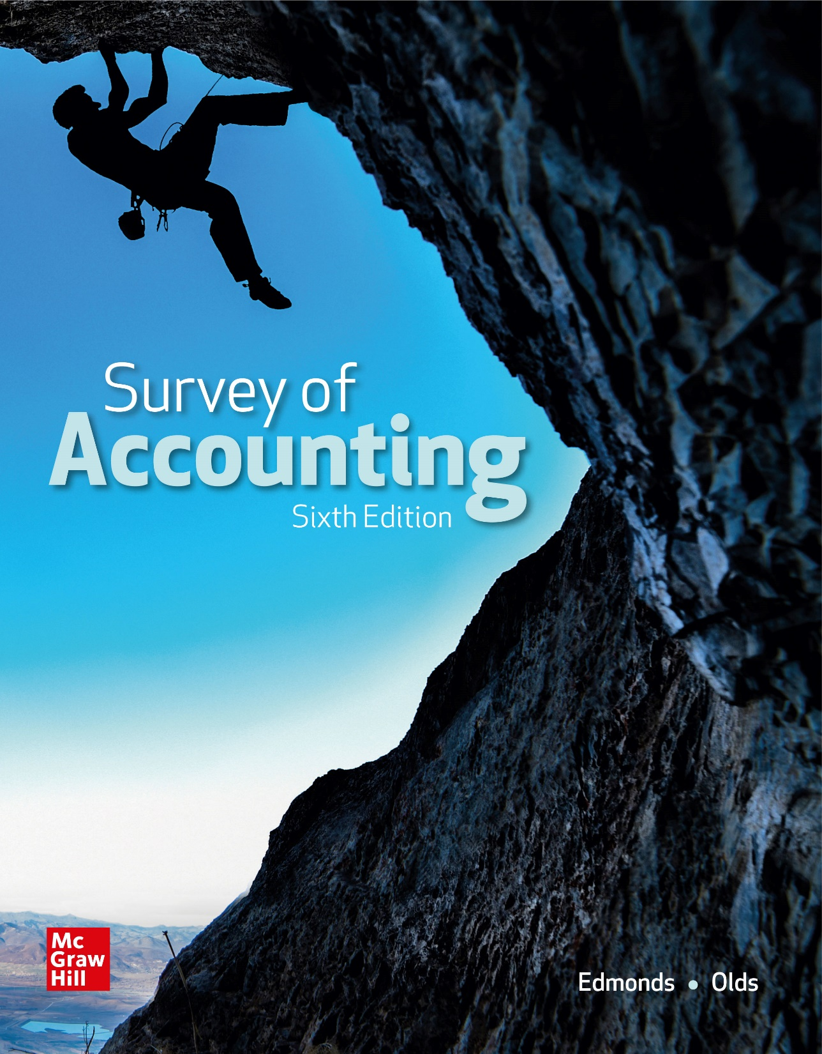
Chapter 3
Accounting for Merchandising Businesses

Slide 2
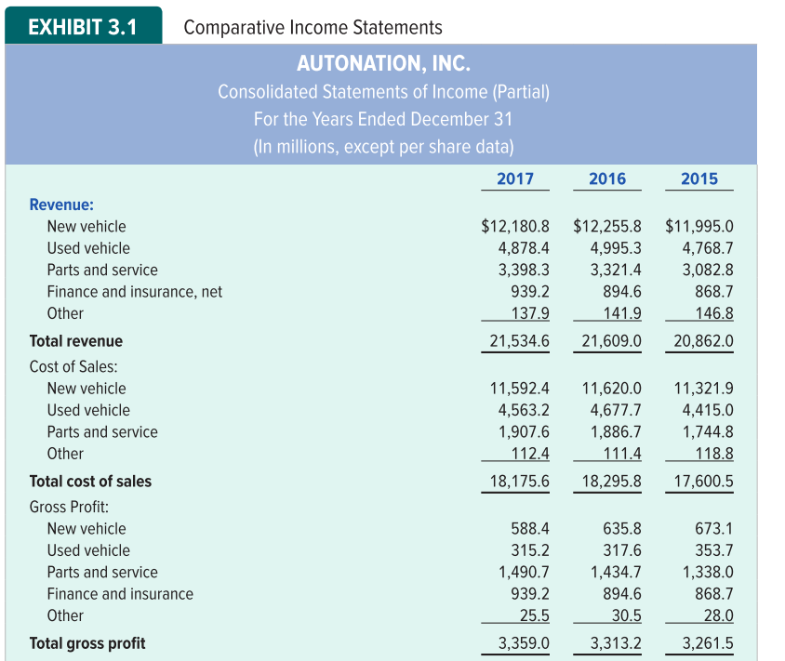
Comparative Income Statements Part 1

Slide 3
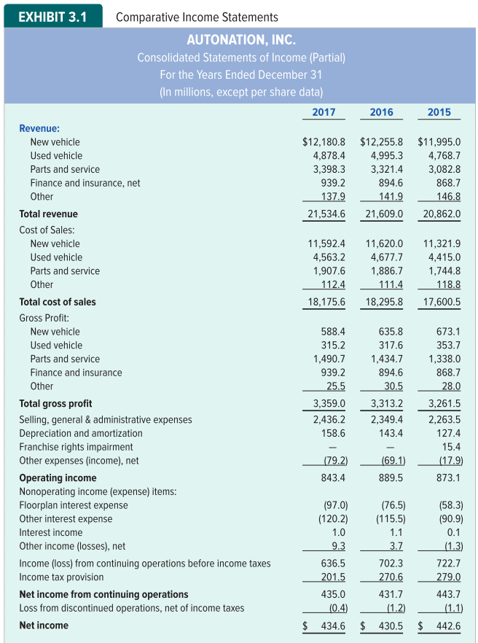
Comparative Income Statements Part 2

Slide 4
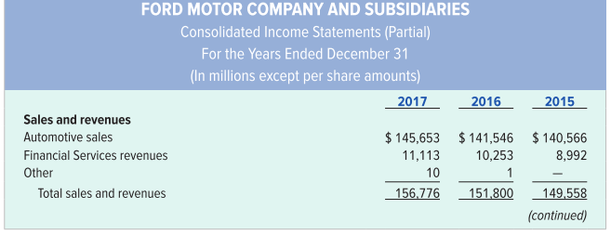
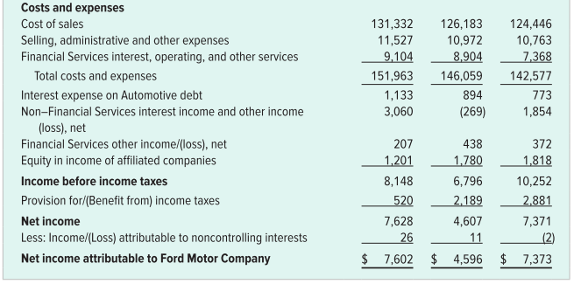
Additional Comparative Income Statements

Slide 5
Merchandising Businesses
Merchandising businesses generate revenue by selling goods.
They buy the merchandise they sell from companies called suppliers.
The goods purchased for resale are called merchandise inventory.
Merchandising businesses include retail and wholesale companies.

Slide 6
Product Costs Versus Selling and Administrative Costs
Product Costs
Selling & Admin. Costs
All costs incurred to acquire merchandise and ready it for sale.
Costs that are not included in inventory. They are sometimes called period costs.

Slide 7
LO 3-1:
Record and report on inventory transactions using the perpetual system.

Slide 8
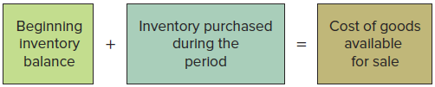
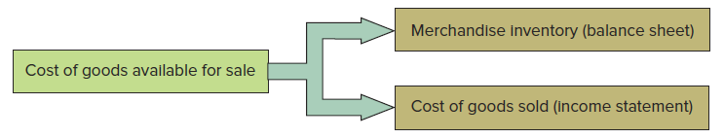
Allocating Inventory Cost Between Asset and Expense Accounts

Slide 9
Gross Margin (or Gross Profit)
The difference between the sales revenue and the cost of goods sold is called gross margin or gross profit.

Slide 10
Net Income
The selling and administrative expenses (period costs) are subtracted from gross margin to obtain the net income.

Slide 11
Perpetual Inventory System
Perpetual Inventory System
Inventory increased for each item purchased
Inventory account is adjusted perpetually (continually) throughout the accounting period.
Inventory decreased for each item sold

Slide 12
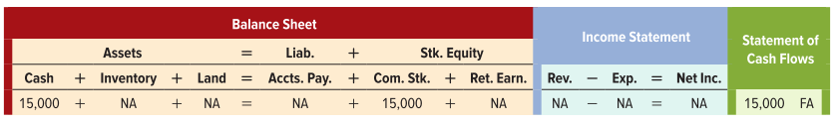
Effects of Year 1 Events on Financial Statements
Event 1: JPS acquired $15,000 by issuing common stock.
Asset Source Transaction

Slide 13
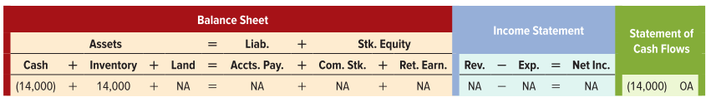
Effects of Year 1 Events on Financial Statements
Event 2: JPS purchased merchandise inventory for $14,000 cash.
Asset Exchange Transaction

Slide 14
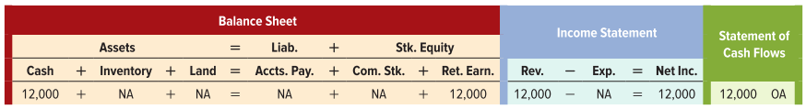
Effects of Year 1 Events on Financial Statements
Event 3A: JPS recognized sales revenue from selling inventory for $12,000 cash.
Asset Source Transaction

Slide 15
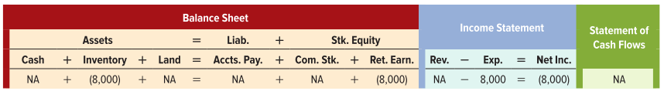
Effects of Year 1 Events on Financial Statements
Event 3B: JPS recognized $8,000 of cost of goods sold.
Asset Use Transaction

Slide 16
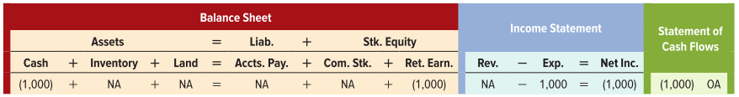
Effects of Year 1 Events on Financial Statements
Event 4: JPS paid $1,000 cash for selling expenses.
Asset Use Transaction

Slide 17
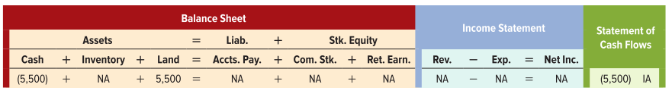
Effects of Year 1 Events on Financial Statements
Event 5: JPS paid $5,500 cash to purchase land to locate a future store.
Asset Exchange Transaction

Slide 18
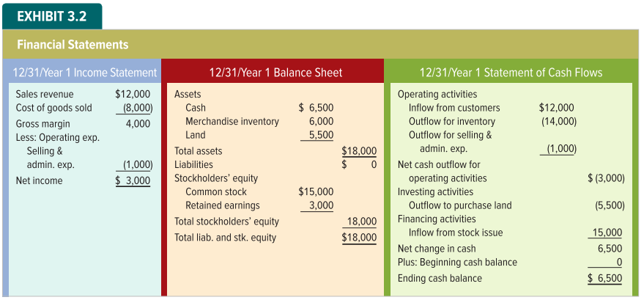
Financial Statements for Year 1

Slide 19
Transactions Related to Inventory Purchases
Purchasing inventory often involves
Returning inventory or receiving purchase allowances
Taking purchase discounts
Incurring transportation costs
Recognizing inventory shrinkage

Slide 20
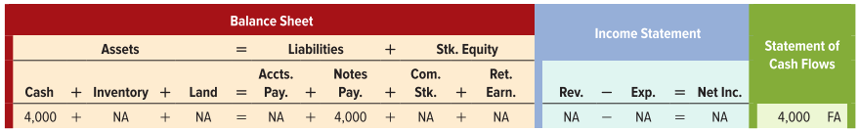
Effects of Year 2 Events on Financial Statements
Event 1: JPS borrowed $4,000 cash by issuing a note payable.
Asset Source Transaction

Slide 21
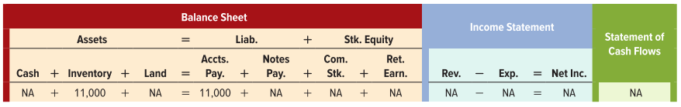
Effects of Year 2 Events on Financial Statements
Event 2: JPS purchased on account merchandise inventory with a list price of $11,000.
Asset Source Transaction

Slide 22
LO 3-2:
Show how purchase returns and allowances affect financial statements.

Slide 23

Accounting for Purchase Returns and Allowances
Event 3: JPS returned some of the merchandise purchased in Event 2. The list price of the returned merchandise was $1,000.
Asset Use Transaction

Slide 24
LO 3-3:
Show how purchase discounts affect financial statements.

Slide 25
Cash Discounts
A deduction from the invoice price granted to induce early payment of the amount due.
Terms
Time
Due
Discount Period
Credit Period
Full amount
less discount
Full amount due
Purchase or Sale

Slide 26
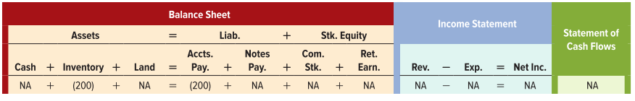
Accounting for Purchase Discounts
Event 4: JPS received a cash discount on goods purchased in Event 2. The credit terms were 2/10, n/30.
($11,000 goods purchased - $1,000 returned) = $10,000 net purchases x .02 = $200 discount.
Asset Use Transaction

Slide 27
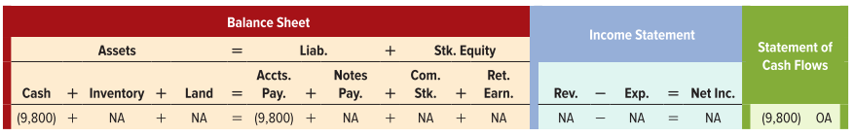
Balance Due on Accounts Payable
Event 5: JPS paid the $9,800 balance due on the account payable.
Asset Use Transaction

Slide 28
LO 3-4:
Show how transportation costs affect financial statements.

Slide 29

Transportation Costs
The terms FOB shipping point and FOB destination identify whether the buyer or the seller is responsible for transportation costs.
FOB shipping point means the buyer is responsible for the freight cost, called transportation-in.
FOB destination means the seller is responsible for the freight cost, called transportation-out.

Slide 30
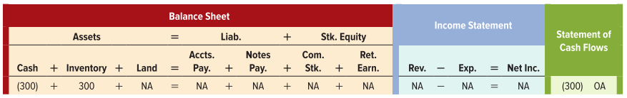
Accounting for Transportation Costs
Event 6: The shipping terms for the inventory purchased in Event 2 were FOB shipping point. JPS paid the freight company $300 cash for delivering the merchandise.
Asset Exchange Transaction

Slide 31
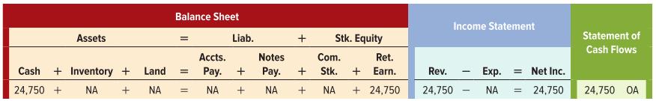
Cash Sale of Merchandise
Event 7A: JPS recognized $24,750 of revenue on the cash sale of merchandise that cost $11,500.
Asset Source Transaction

Slide 32
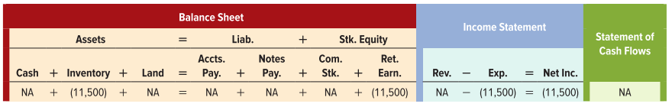
Cost of Cash Sale of Merchandise
Event 7B: JPS recognized $11,500 of cost of goods sold.
Asset Use Transaction

Slide 33

Paid Cash for Freight Costs
Event 8: JPS paid $450 cash for freight costs on inventory delivered to customers.
Asset Use Transaction

Slide 34
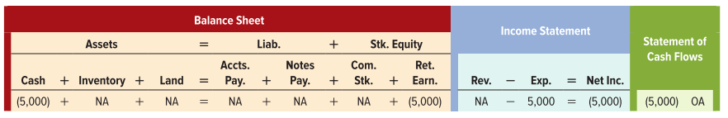
Paid Cash for Selling and Administrative Expenses
Event 9: JPS paid $5,000 cash for selling and administrative expenses.
Asset Use Transaction

Slide 35
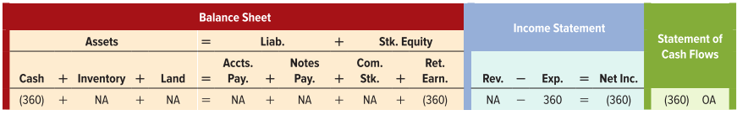
Paid Cash for Interest Expense
Event 10: JPS paid $360 cash for interest expense on the note described in Event 1.
Asset Use Transaction

Slide 36
LO 3-5:
Show how inventory shrinkage affects financial statements.

Slide 37
Merchandising Businesses: Shrinkage
Most merchandise companies experience some level of inventory shrinkage, a term that reflects decreases in inventory for reasons other than sales to customers. Inventory may be:
Stolen by shoplifters
Damaged by customers or employees
Lost or misplaced

Slide 38
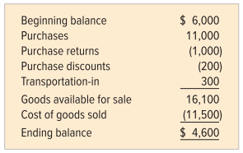
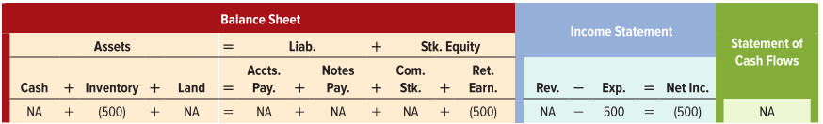
Accounting for Inventory Shrinkage
Event 11: JPS took a physical count of its inventory and found $4,100 of inventory on hand.
Asset Use Transaction

Slide 39
LO 3-6:
Calculate gains and losses and show how they are presented on a multistep income statement.

Slide 40
Gross Margin and Gain
When merchandise inventory is sold for more than it cost, the difference is called the gross margin
When JPS sells land for more than it cost, the difference between the sales price and the cost of the land is called a gain.
The terms are used to alert users to the fact that the nature of the underlying transactions is different

Slide 41

Recognizing Gains and Losses
Event 12: JPS sold the land that cost $5,500 for $6,200 cash.
Asset Exchange Transaction

Slide 42
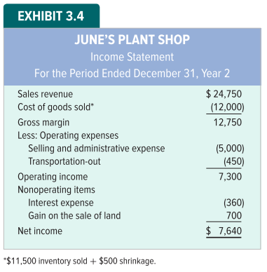
Multi-Step Income Statement Example

Slide 43
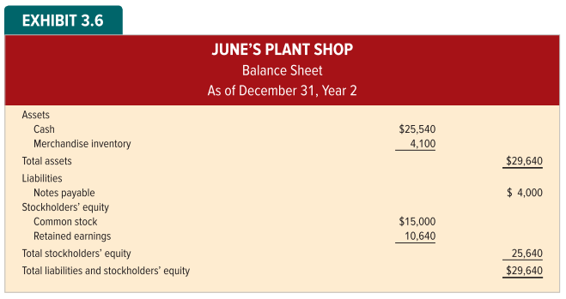
Balance Sheet

Slide 44
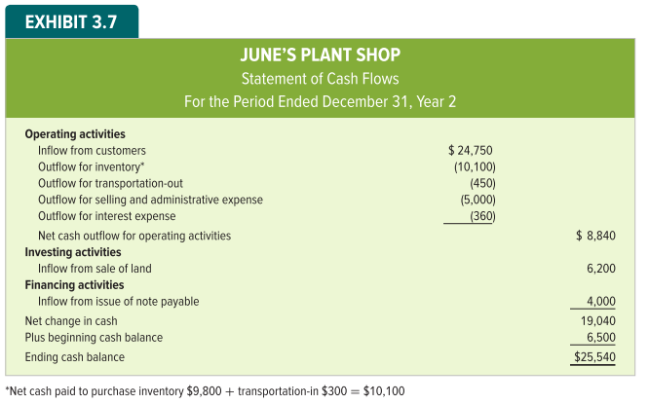
Statement of Cash Flows

Slide 45
LO 3-7:
Determine the amount of net sales.

Slide 46
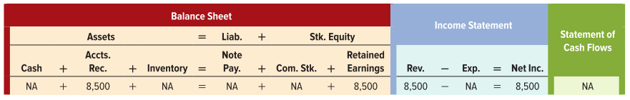
Events Affecting Sales
Event 1A: JPS sold on account merchandise with a list price of $8,500. Payment terms were 1/10, n/30. The merchandise had cost JPS $4,000.
Asset Source Transaction

Slide 47
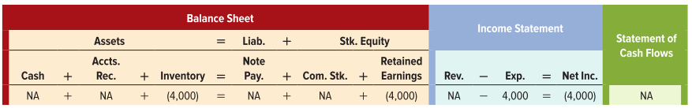
Events Affecting Sales
Event 1B: JPS recognized $4,000 of cost of goods sold.
Asset Use Transaction

Slide 48
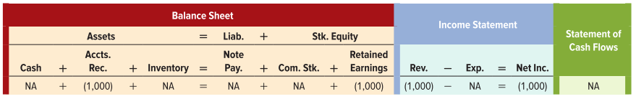
Accounting for Sales Returns and Allowances
Event 2A: The customer from Event 1A returned inventory with a $1,000 list price. The merchandise had cost JPS $450.
Asset Use Transaction

Slide 49

Accounting for Sales Returns and Allowances
Event 2B: The cost of the goods ($450) is returned to the inventory account.
Asset Source Transaction

Slide 50
LO 3-9:
Identify the primary features of the periodic inventory system (Appendix).

Slide 51
Periodic Inventory System
Inventory costs
Purchases account
Purchase returns & allowance
Purchase return account
Purchase allowances account
Transportation costs
Transportation-in account

Slide 52
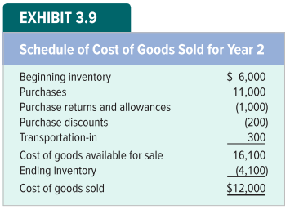
Periodic Inventory System Continued
No entries made in Inventory account during period
Cost of goods sold determined at end of period

Slide 53
Periodic Inventory System — Advantages and Disadvantages
Advantage
Recording efficiency
Disadvantage
Less control of inventory
Does not separate cost of lost, damaged, or stolen merchandise from cost of goods sold

Slide 54
End of Chapter 3

